Slide 1
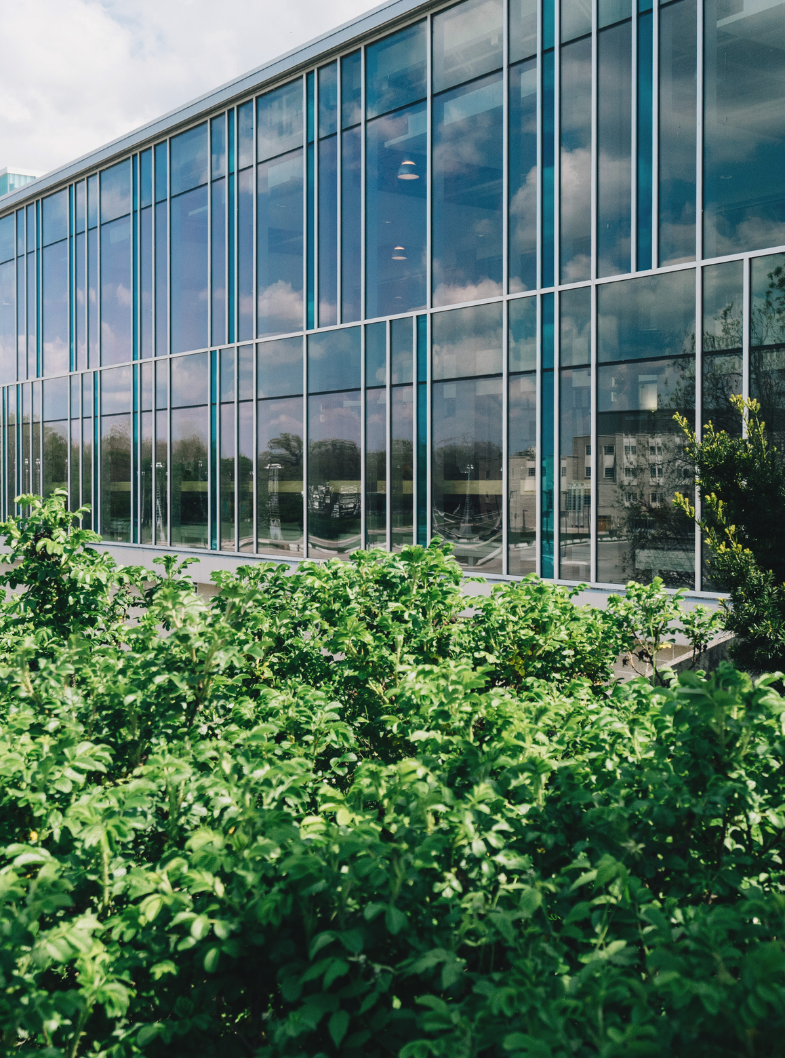

Consultancy Experience Project
Consultancy Experience Project
Consultancy Experience Project
Feasible Study on Ginger Production in the UK
Welcome
Welcome
Alaister Hawkens

Slide 2








OUR TEAM
GET TO KNOW OUR TEAM!
CHARLIE
LIMICA
HEMBRAT
DR PADMI NAGIRIKANDALAGE
ENUSHI
THAO VAN

Slide 3
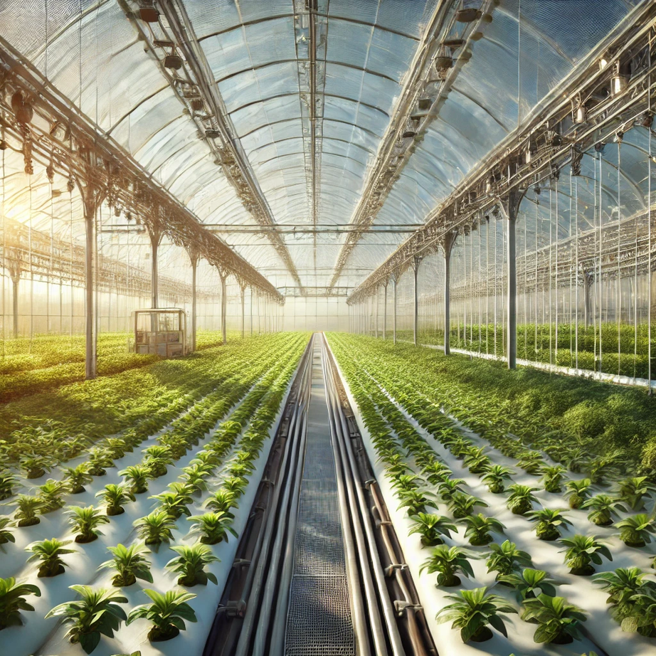
Introduction
Optimised Farming Techniques: We will help you leverage advanced farming methods like polytunnels and vertical farming to maximise yield and profitability.
Market Competitiveness: Our consultancy ensures your venture can compete effectively by meeting market demand and reducing import dependency.
Sustainability Focus: We promote sustainable farming practices that contribute to long-term environmental and economic benefits.

Slide 4

Ginger Market: UK
Growing Demand :
Health benefits: anti-inflammatory, anti-nausea, digestive properties
Popular in culinary uses: savory and sweet dishes
Rising wellness trends: teas, detox drinks, dietary supplements
Import Dependency
UK imports 60% of ginger from China, India, and Peru
Supply chain disruptions: geopolitical issues, tariffs, transportation
Market Growth Projections
Global ginger market: $3 billion in 2020, 6% CAGR
UK market growth: 5% annual increase
Competitive Landscape
Major importers and distributors dominate
Unique selling proposition: superior freshness, sustainability, support for local economies
Local Production Benefits
Fresher produce
Reduced carbon footprint
Economic impact: job creation, rural growth
Consumer preference for locally sourced and organic produce

Slide 5


Potential for Local Ginger: UK
Valued at £3.1bn in 2022 with shoppers spending £8.5m a day on organic products experiencing the 11th year of continuous growth. With 25.4% growth since the pandemic.
The Soil Association indicated that 81% of consumers in the UK prefer to buy local produce supporting the home grown ginger market.
There has been increases in the number of farmers markets, over 500. These are crucial for home grown produce attracting the consumers looking for local produce with total sales at these markets being worth £3bn.
Ginger is a key part of the health market through its health benefits, increasing the demand. The health market is valued at £20bn in 2021

Slide 6

Aims and Objectives of the Project
Aim:
To evaluate the financial feasibility of growing ginger locally in Lincolnshire.
Objectives:
Conduct Detailed Cost Analysis and Financial Modelling.
Perform Risk Assessment and Mitigation.
Implement and Evaluate Pilot Project.
Measure Environmental and Economic Impact.
Compare Cultivation Methods.

Slide 7













Assumptions
The cultivation of the projected cash flow is for 9 month duration of life cycle.
We have compared UK value with China and UK and Peru and India because they are major players in ginger.
We have assumed the land measurement to be one hectare.
We have assumed specific methods and technique to individual steps to produce efficient ginger.
The projected Cash Flows are cumulative Cash Flows, not the Discounted Cash Flows.
(Detail information will be given in business report).

Slide 8
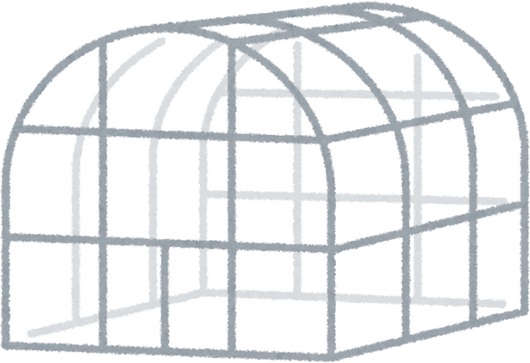
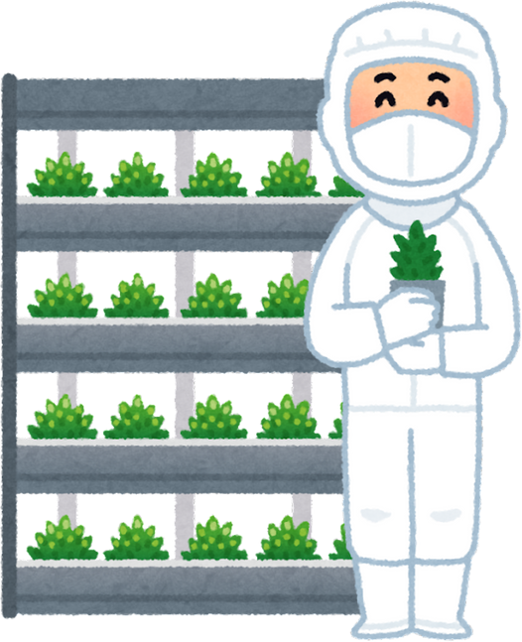

Farming Techniques
 | Polytunnels | Vertical Farming
Advantages | Year-Round Cultivation- Weather Protection- Versatility- Controlled Environment | Optimal Space Utilization- Environmental Control- Reduced Emissions- Advanced Technologies
Disadvantages | - High Initial Costs- Environmental Impact- Space Requirements- Climate Control Challenges | High Initial Costs- Technical Requirements- Energy Consumption
Estimated Yield Per hectare | Estimated Yield 20,000 to 30,000 kg per hectare annually. | Estimated Yield 1,00,000 kg per hectare annually.
Nutrition and Carbon Emission | Enhanced bioactive compounds- Renewable energy sources reduce carbon footprint | Enhanced bioactive compounds- Renewable energy sources reduce carbon footprint
Estimated price in UK | Estimated setup cost £78,500 per hectare. | Estimated Setup cost £2,340,000 per hectare.

Slide 9
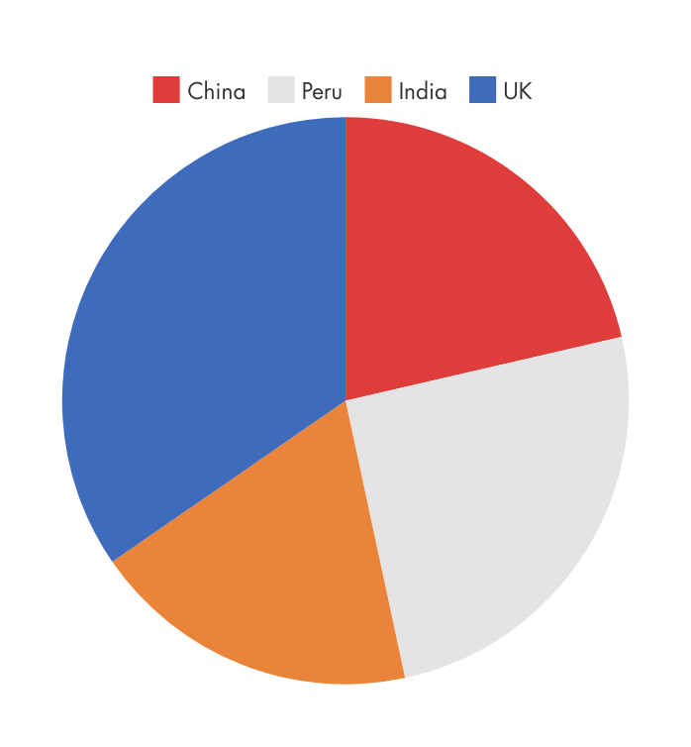
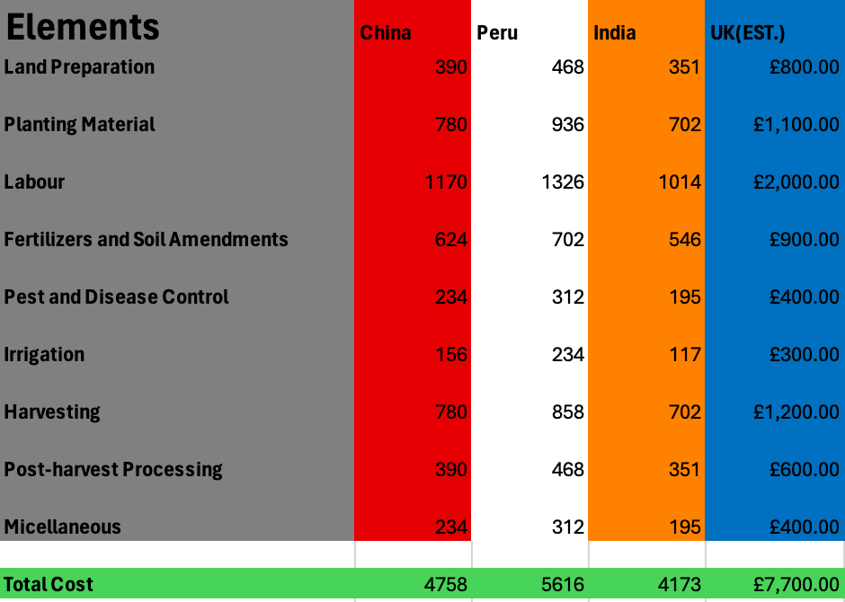





Total Agriculture Cost

Slide 10
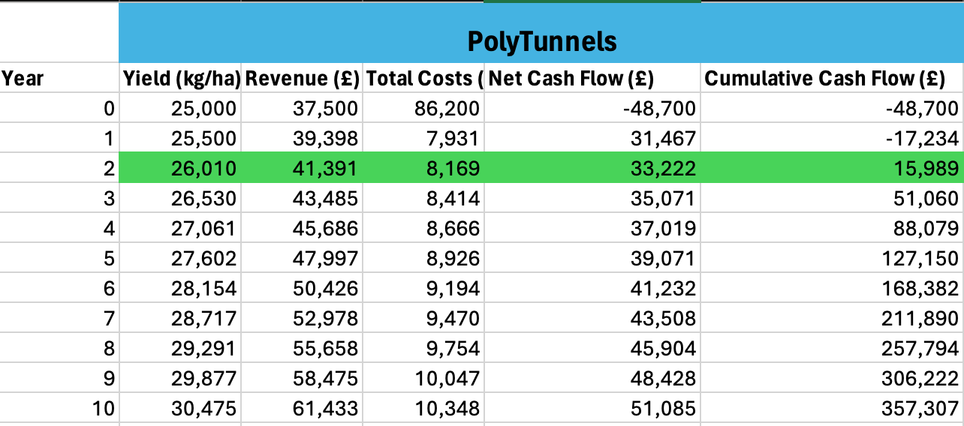
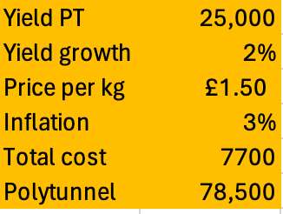
Cash Flows

Slide 11
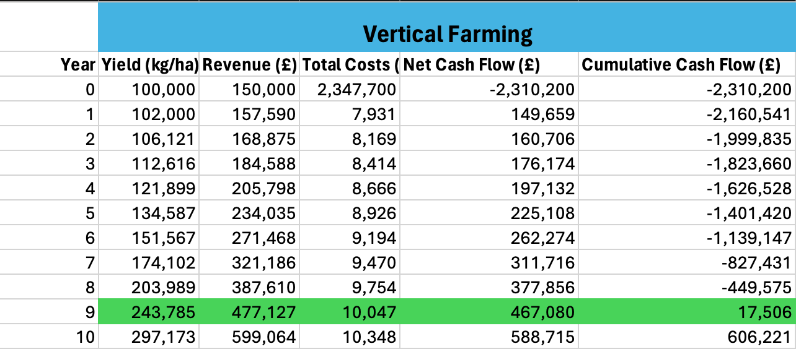
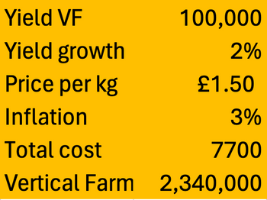
Cash Flows

Slide 12

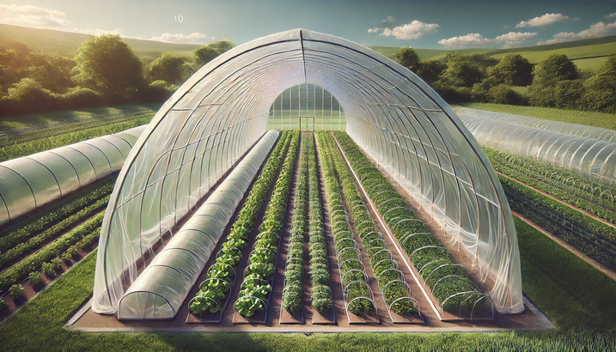
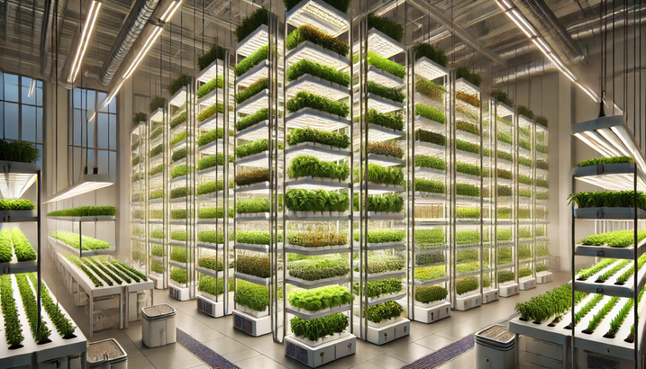


Economic Viability
Polytunnels
Vertical Farming
Year 1 to 10: Yield growth, revenue increase, and cumulative cash flow.
Break-even: Achieved within 2-3 years.
Total 10-Year Cumulative Cash Flow: £357,307.
Year 1 to 10: Higher initial costs but significant yield and revenue growth.
Break-even: Achieved by Year 9.
Total 10-Year Cumulative Cash Flow: £606,221.

Slide 13


RISKS INVOLVED IN PRODUCING GINGER
FOR POLYTUNNEL AND VERTICAL FARMING
POOR CLIMATE CONTROL
HIGH INITIAL INVESTMENT
TECHNO-
LOGICAL DEPENDENCE
WATER MANAGE-MENT ISSUES
DISEASE AND PEST RISKS
Leads to reduced yields, poor-quality ginger, and increased disease susceptibility.​
Significant upfront costs for infrastructure (racks, lighting, irrigation, climate control) may not be quickly recovered.​
Reliance on technology for climate control, irrigation, and lighting increases the risk of crop damage or loss if systems fail.​
Poor water management can cause root rot, nutrient leaching, or drought stress.​
Closed environments increase the risk of disease outbreaks and pest infestations, requiring strict sanitation practices to prevent crop losses.​

Slide 14



Apply balanced nutrients based on soil tests.
Adopt organic farming practices to meet the growing the demand for organic products and reduce chemical inputs.
Conduct frequent fields of inspections to defect to manage pests.
STRATEGIES FOR MITIGATION OF LOSS
Implementing renewables energy, efficient irrigation system sustainable packaging, and optimised logistics further minimises resources use and environment impact, enhancing the overall sustainability of ginger production
Consider the tissue cultured plants to ensure uniformity and disease resistance.

Slide 15


Carbon Emission
Farming Practices
Deforestation and Land Conversion: Converting natural ecosystems to agricultural land releases stored carbon.
Synthetic Fertilizers: Production and application of nitrogen-based fertilizers result in CO2 and N2O emissions.
The carbon footprint of irrigation depends on the energy source. Efficient irrigation techniques (e.g., drip irrigation) reduce water and energy use, thus lowering emissions.
•
Energy Consumption in Farming
Machinery and Equipment
Fuel Use: Tractors, tillers, and harvesters run on diesel or gasoline, contributing to CO2 emissions.
Greenhouse Heating
Energy Sources: In the UK, greenhouses used for ginger cultivation may require heating, especially during colder months. The carbon footprint depends on whether the energy comes from fossil fuels or renewable sources.

Slide 16
Carbon Emission
Transportation
Vehicle Emissions: Transporting ginger from farms to processing facilities involves CO2 emissions.
Imports
International Shipping: If ginger is imported, maritime shipping emits CO2, but at a lower rate per ton-kilometer compared to air freight, which has a much higher carbon footprint.
Processing
Drying: Industrial drying processes can be energy-intensive. Solar drying methods offer a low-carbon alternative.
Making Ginger Syrup- The juice is concentrated into syrup through evaporation, which requires sustained heating.
Packaging: The production of packaging materials (e.g., plastic, cardboard) also involves emissions. Recyclable and biodegradable packaging can reduce the carbon footprint.
Waste Management
Organic Waste: Composting ginger waste can produce methane, but this can be minimized through proper aerobic composting techniques.

Slide 17

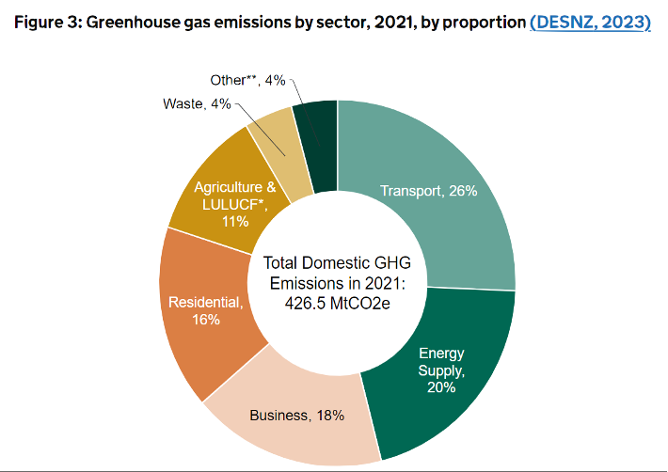
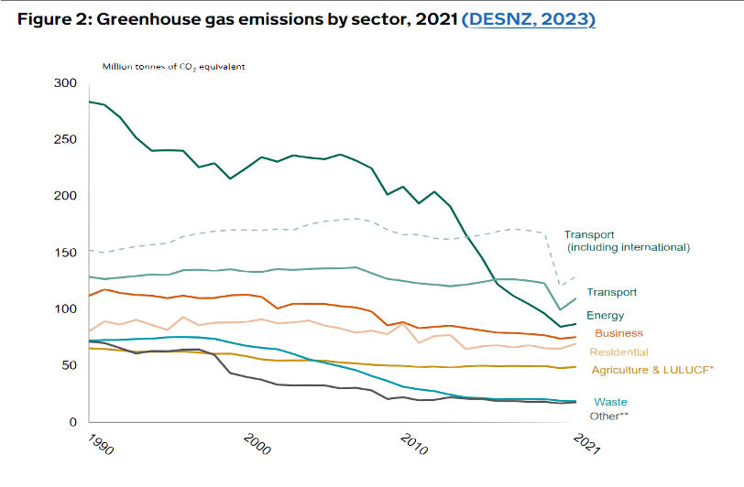

Distribution of Greenhouse gas emissions in the United Kingdom (UK) in 2021, by sector.
In 2023 distribution of gas emission in the United Kingdom by sector,
Transport – 26%
Energy Supply -20%
Business – 18%
Residential -16%
Agriculture – 11%
Waste – 4%
Other-4%

Slide 18





Recommendations
Adopt Vertical Farming Techniques:
Maximise yield and space efficiency, especially in urban areas.
Implement hydroponic or aeroponic systems to minimise water usage.
Use renewable energy sources like solar or wind power.
Utilise Polytunnels for Year-Round Cultivation:
Protect crops from adverse weather conditions.
Implement crop rotation and organic farming techniques.
Lower initial setup costs compared to vertical farming with substantial yield improvements.
Focus on Market Competitiveness:
Reduce reliance on imports from China, India, and Peru.
Mitigate risks associated with supply chain disruptions and geopolitical issues.
Support local economy through job creation and rural development.
Provide fresher produce and reduce transportation emissions.
Conduct Detailed Financial and Environmental Assessments:
Continuously evaluate the financial feasibility of farming techniques.
Measure environmental benefits to ensure long-term viability.
Ensure compliance with regulatory standards.
Implement Advanced Farming Practices:
Utilise renewable energy sources for farming operations.
Adopt efficient irrigation systems to conserve water.
Use recyclable or biodegradable packaging materials.

Slide 19



